Slide 1

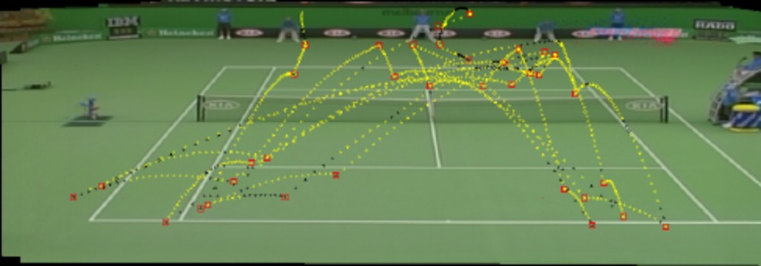
“BALL TRACKER”

Slide 2

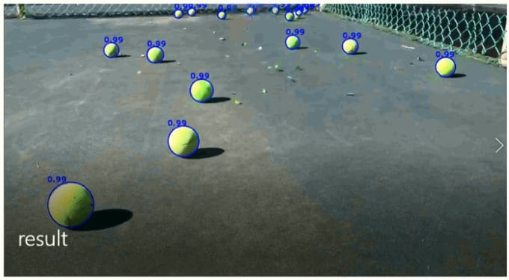
INTRODUCTION:
Sports is equivalent to motion: people and objects moving in different speeds and directions.
The capability to track moving objects and analyze them plays a crucial role.

Slide 3
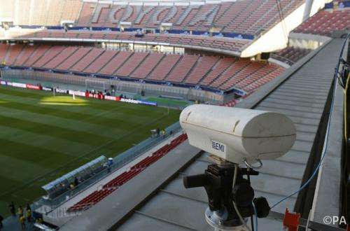
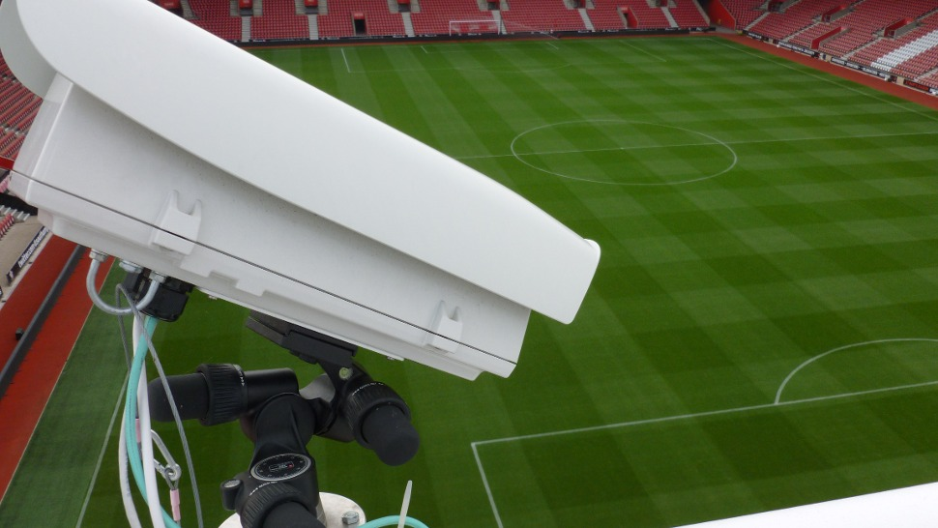
OBJECTIVE:
We want to evaluate the quickest way to detect the ball in a sport event in order to develop an Sports AI without spending a million dollars on tech or developers.
Quickly we find out that detecting the ball is key component to develop a robust Sports AI.

Slide 4
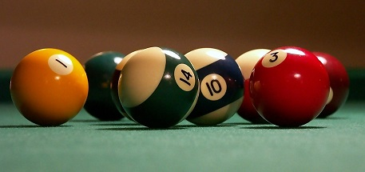
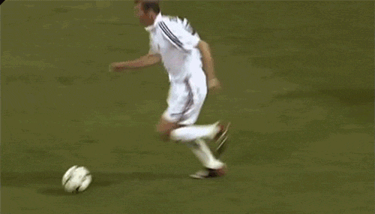
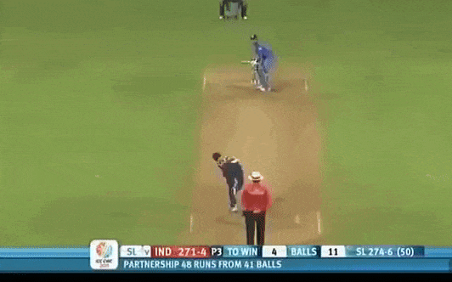
WHY SHOULD WE CARE ?
In the AI Sports ,it is totally relevant for you to know the state of the art in ball detection, this object is always the main center of attention of any sport. If you can detect the ball (even at high speeds) then you will be able to detect easier key events of the game, metrics and so much more useful information.

Slide 5



Software used:
Python
OpenCV
Tkinter

Slide 6
Advantages
To make the camera track ball automatically like in case of football.
For making more precise decision , like in case of 3rd umpire in cricket.
To evaluate the quickest way to detect the motion of ball
For detailed analysis of movement of a ball.
To track the planetary motion.
It can even be enhanced to track other objects other than just a ball.

Slide 7
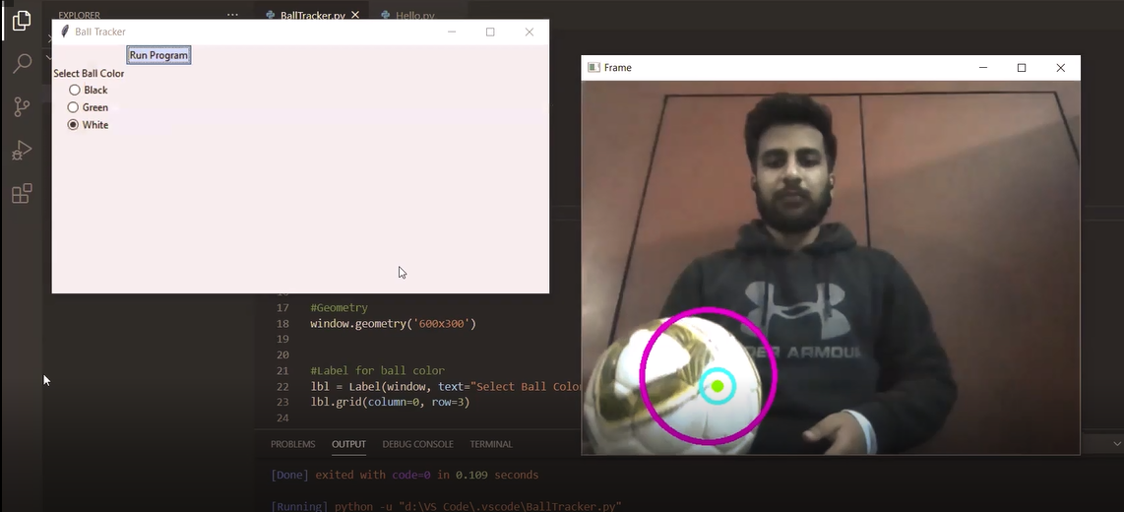
OUTPUT
Screenshot 1:

Slide 8
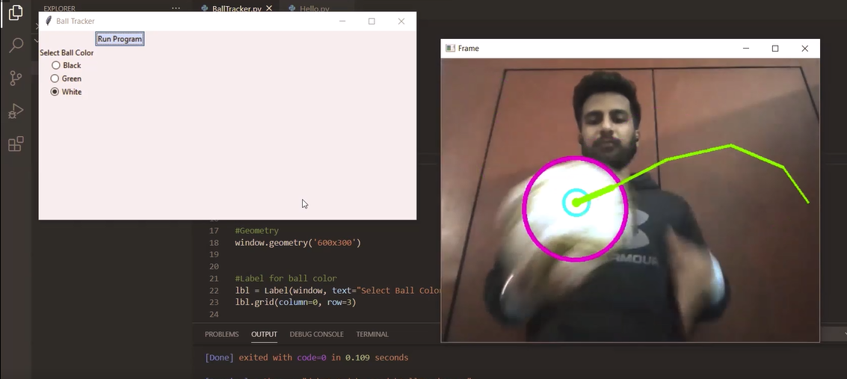
Screenshot 2:

Slide 9
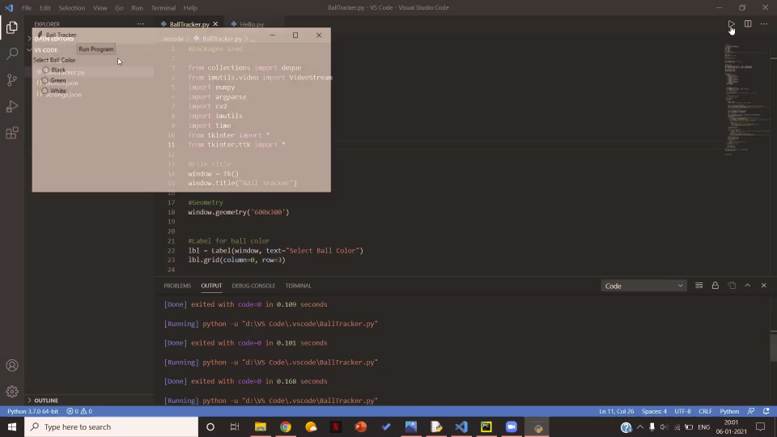
VIDEO -

Slide 10
Reference:
https://en.wikipedia.org/wiki/Hawk-Eye
https://likegeeks.com/python-gui-examples-tkinter-tutorial/
https://www.pyimagesearch.com/2015/09/14/ball-tracking-with-opencv/
https://www.tutorialspoint.com/python3/python_gui_programming.htm

Slide 11
